Slide 1
Computer Aided Design (CAD)

Slide 2
Overview
Background
Videos
Sign-up
Graphic User Interface (GUI)
Tutorials

Slide 3
Background
Roots lie in a program called PRONTO for numerical-control programming
Lead to computer technical drawings
Used to design and space various components in an assembly/part
Use with additive manufacturing (3D printing) to create prototypes
Such as sunglass frames, prosthetics, building frames, electric circuits, etc.
Can use multiple materials as well

Slide 4
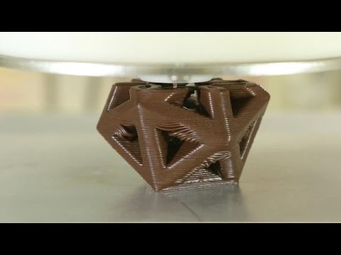
Different materials

Slide 5
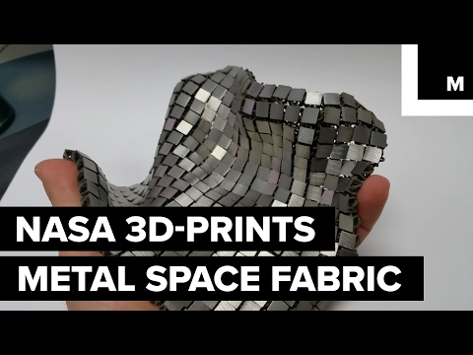
Different usages

Slide 6

Building

Slide 7

OnShape.com
Search up onshape.com
Create account with email
Go to email and activate account
Start using the free software online

Slide 8
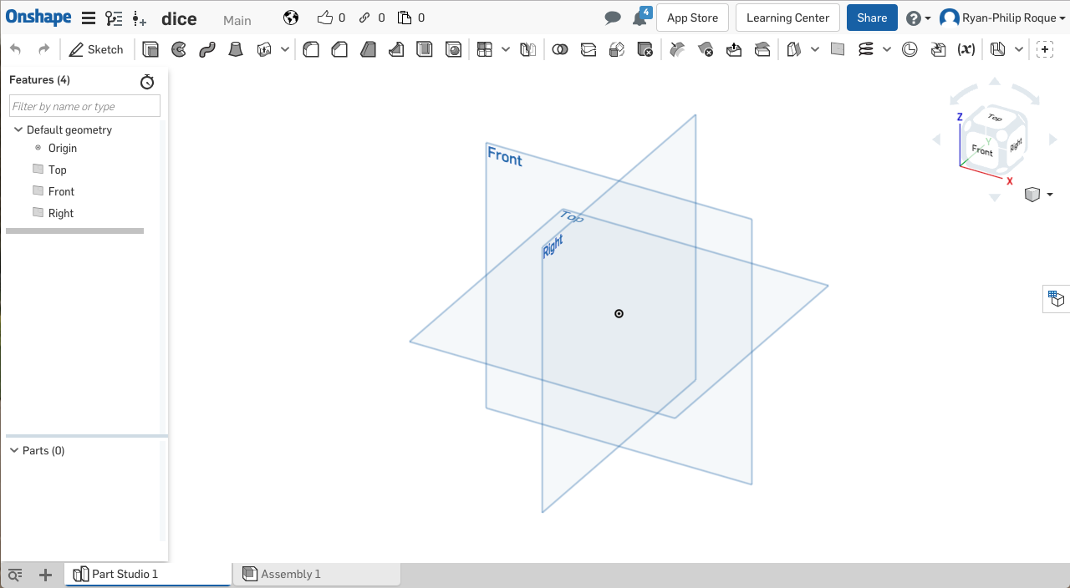

Slide 9
How to CAD
Draw a sketch by picking a plane you want to draw in
At the top menu, select the tools you want to use to draw the shape
After completely done with the shape either
Extrude
Revolve
Usually go back into sketch and edit to fit what you want

Slide 10
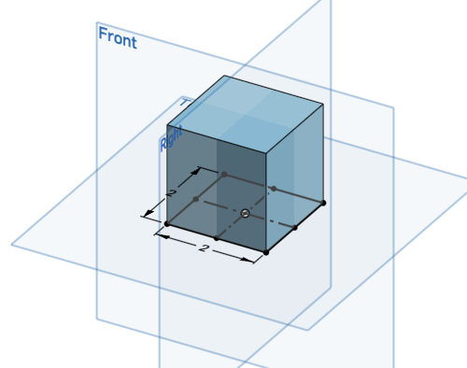
Tutorial #1: Cube
2 in x 2 in x 2 in

Slide 11
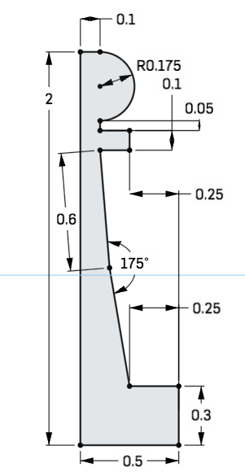
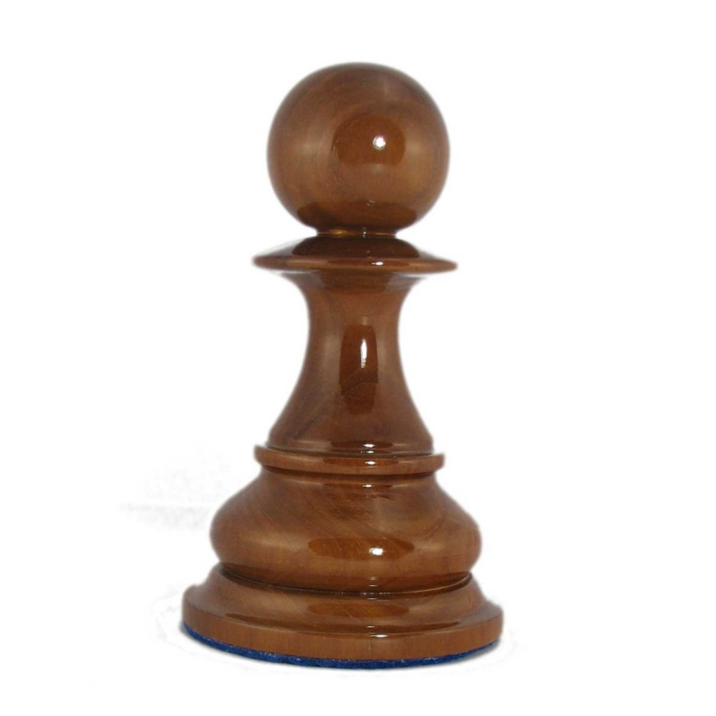
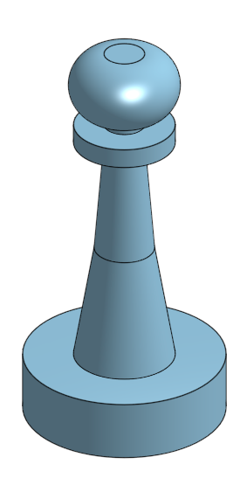
Tutorial #2: Chess Piece

Slide 12
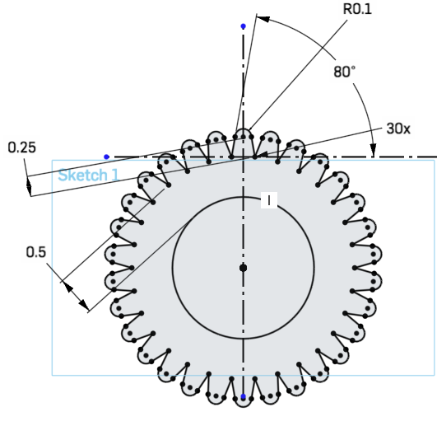
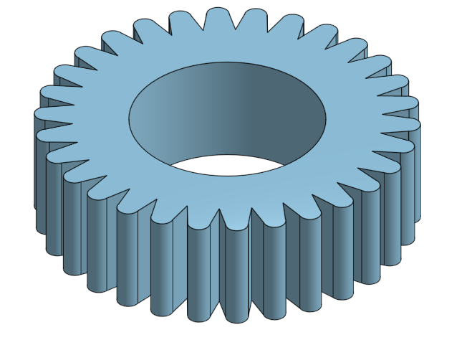
Tutorial #3: Gear

Slide 13
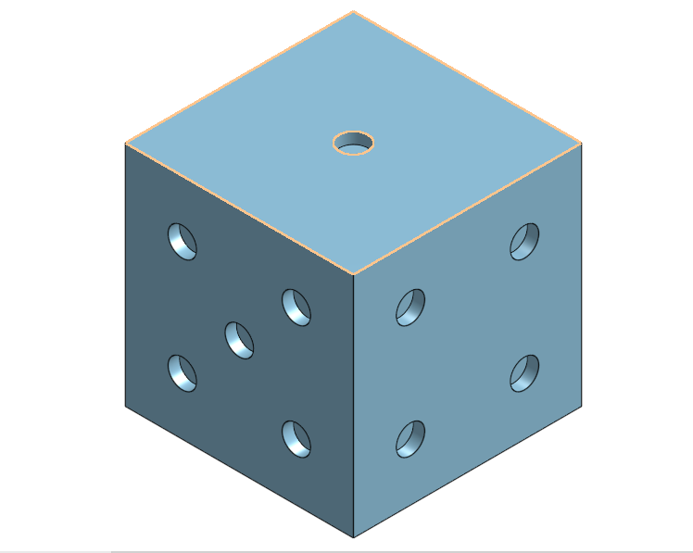
Tutorial #4: Dice

